Slide 1
Quiz app
By- Shashank Chauhan

Slide 2
INTRODUCTION
Quiz application is a collection of different quizzes like technical, general knowledge, English grammar and aptitude, etc.
User can access only one quiz at a time.
To develop user friendly application our application contain:
1. Number of quizzes.
2. Different kind of animations.

Slide 3
CONCEPT
1)Technology used: HTML, CSS, JavaScript.
2)The application has home section and quiz section.
3)In landing page there is 3-D animation, where a block rotating on its axis.
4)In quiz we have made predefined question in javascript , user just need to select right answer and they will be marked accordingly.

Slide 4


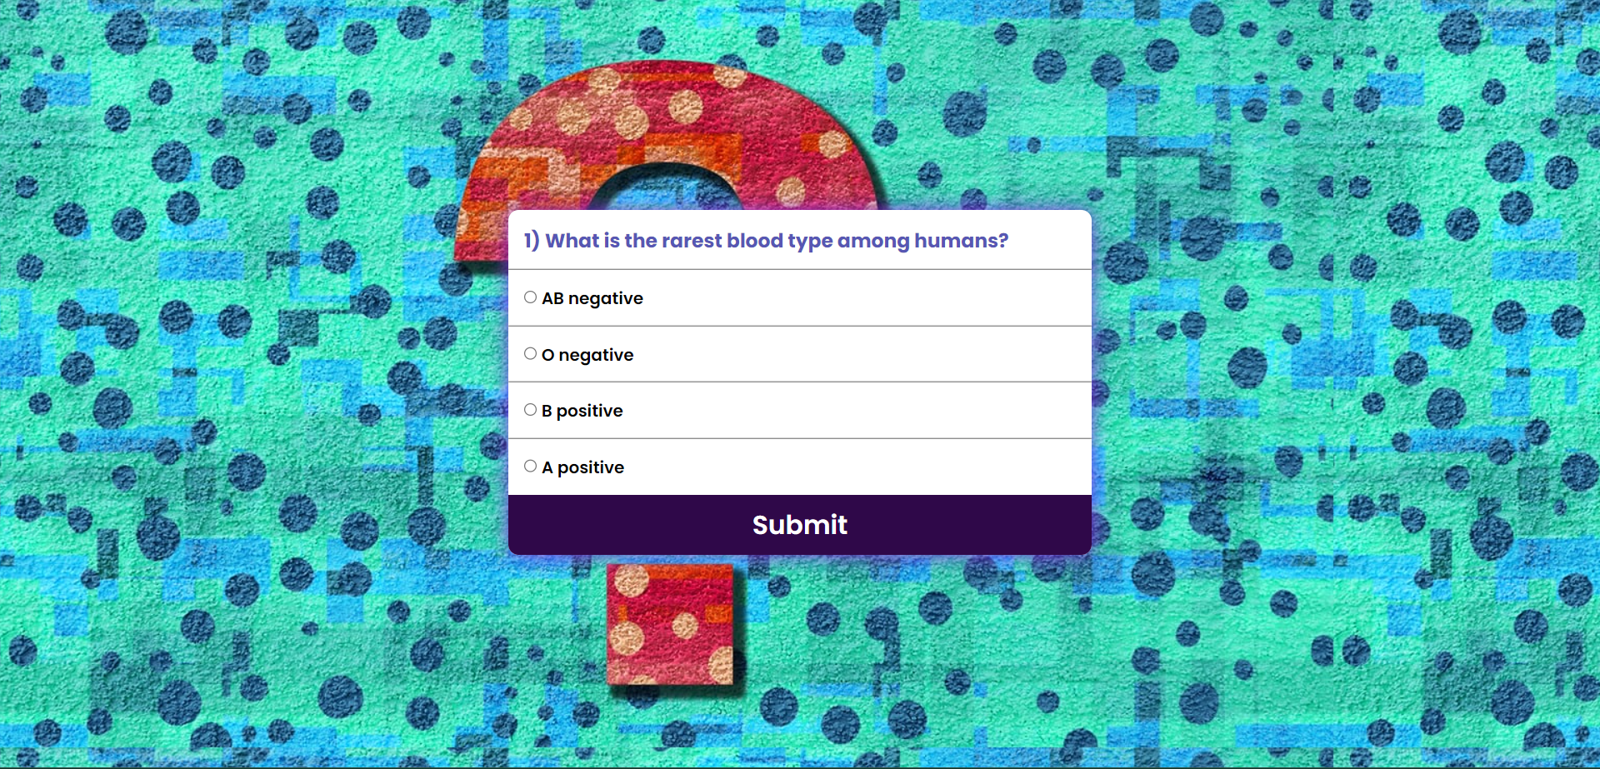
This is landing page
This is quiz page

Slide 5
FUTURE SCOPE
We can add more quizzes in our application like real- time quiz in which we can use API’s to fetch different kinds of quizzes by which users will get new quiz everytime.
Also we will add a feature like “create your own quiz” in which users can make their own quiz can play with their friends .

Slide 6
THANK YOU

